Slide 1
INSTRUMENTS HELPFUL
IN IDENTIFYING WEATHER

Slide 2
Thermometer

Slide 3
Raingauge
Measures
rainfall

Slide 4
Wind vane
Tells the
direction
of the
wind

Slide 5
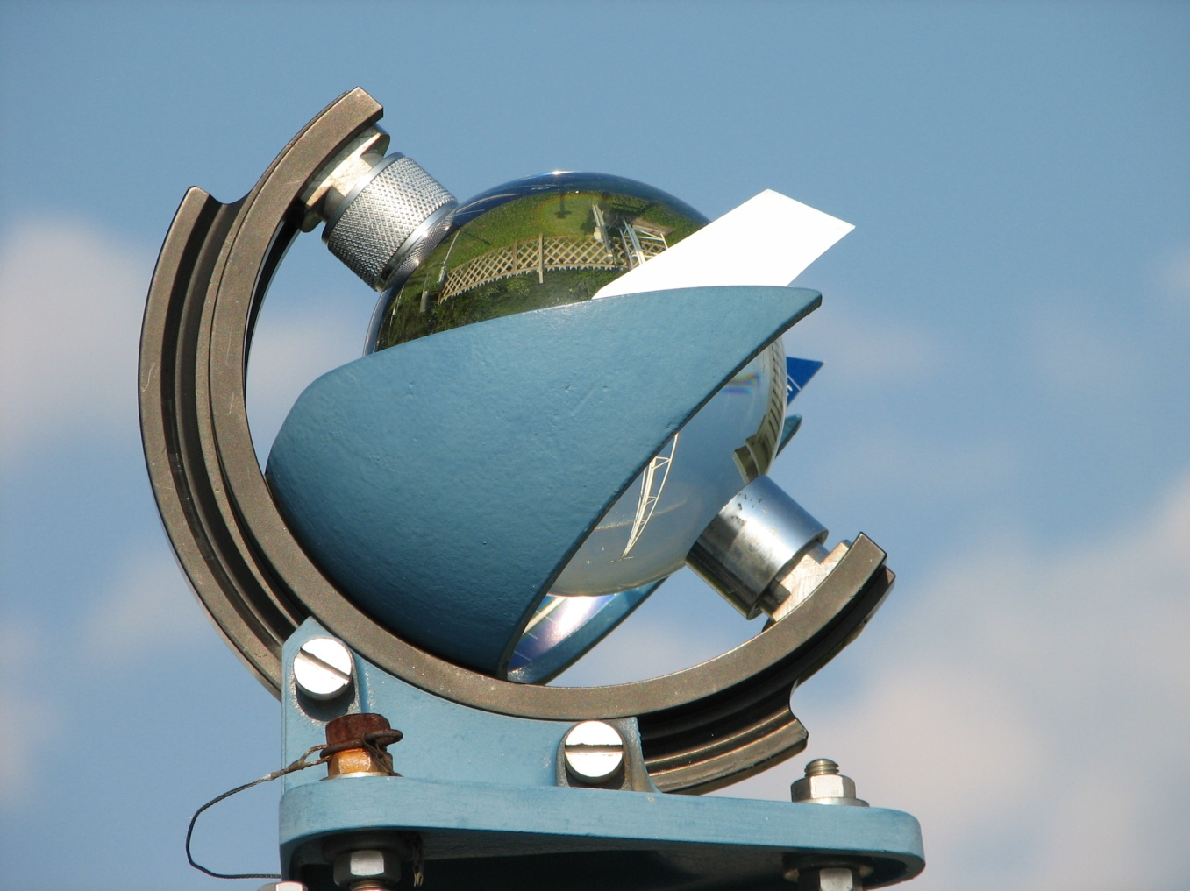
Sunshine recorder
Records the
heat of the
sun

Slide 6
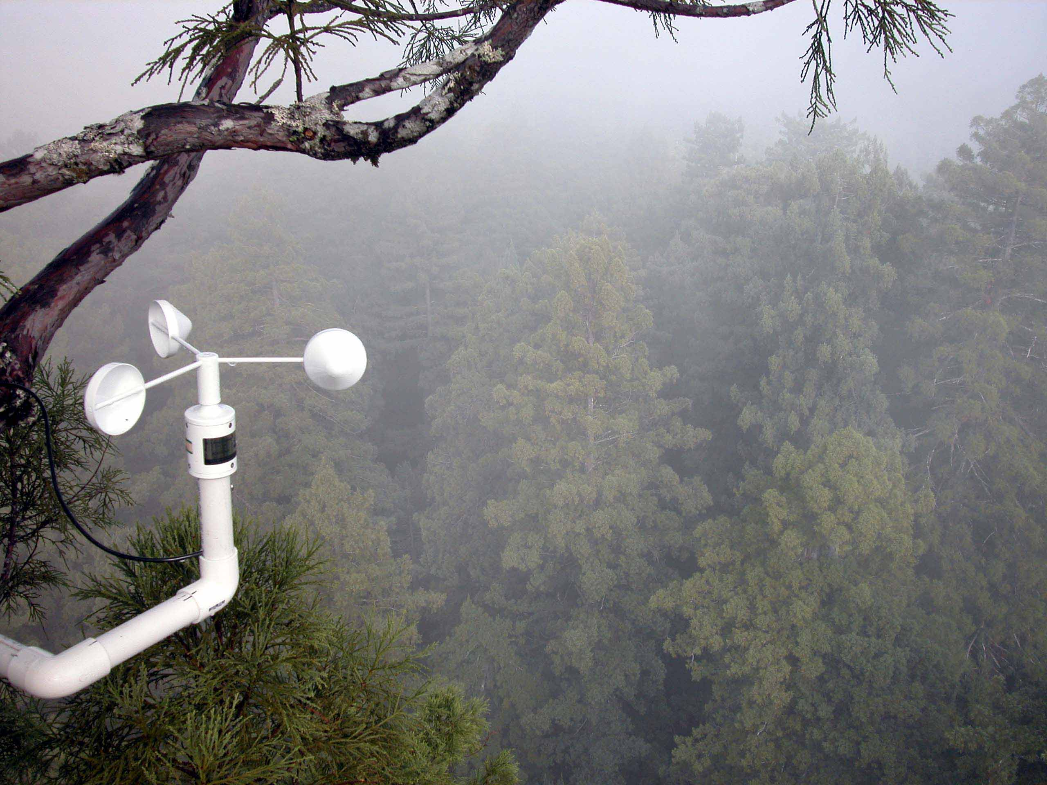
Anemometer
Checks
the speed
of the
wind

Slide 7
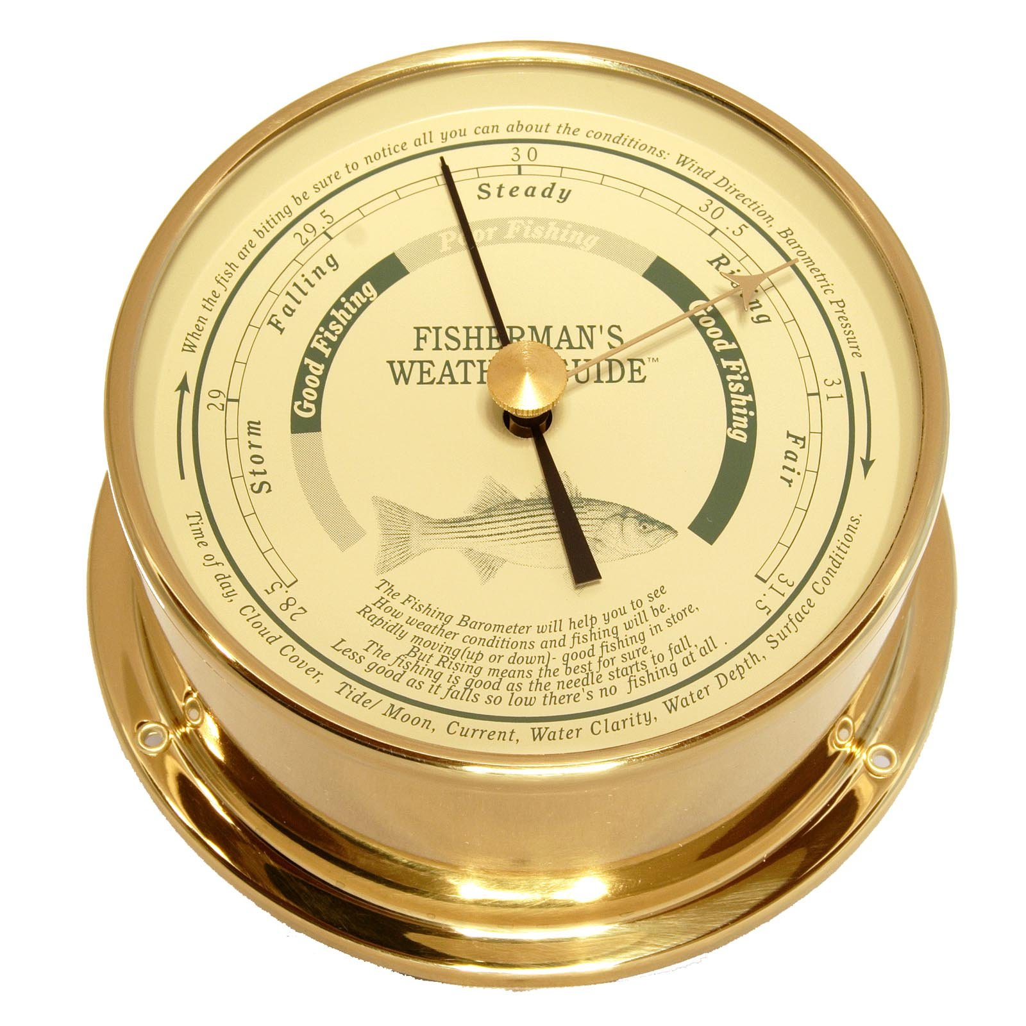
Barometer
Checks
Air pressure

Slide 8
hygrometer
Measures
humidity

Slide 9
Barometer, Hygrometer, Rain gauge,
Sun shine recorder, wind vane, anemometer, thermometer

